Slide 1
COVID-19 and Mental Health:
What We Are Learning from www.mhascreening.org
September 1, 2020

Slide 2
Mental Health and COVID-19: A Growing Crisis
From late February thru August 388,961 people screened moderate to severe for depression or anxiety over and above what we would have expected prior to the COVID-19 pandemic.
From late February thru August an additional 60,233 people screened at risk for psychosis over and above what we would have expected prior to the COVID-19 pandemic.
Since March 1, 131,122 depression screeners reported suicidal or self-harm thinking on more than half the days.

Slide 3
Mental Health and COVID-19: More People Impacted by Anxiety and Depression
The per day number of anxiety screenings completed in August was 535% higher than in January, before coronavirus stress began. The per day number of depression screens was 709% higher in August than in January.
There were over 48,000 moderate to severe anxiety screens (79%) and over 94,000 moderate to severe depression screens (85%).
These impacts on mental health are more pronounced in young people (<25): over 9 in 10 are screening with moderate-to-severe depression, and over 8 in 10 are screening with moderate-to-severe anxiety.
“Loneliness and isolation” is cited by the greatest percent of moderate to severe depression (74%) and anxiety (64%) screeners as contributing to mental health problems “right now.” These percentages have been steady since mid-April.

Slide 4
Mental Health and COVID-19: Thoughts of Suicide & Self-Harm at Epidemic Levels
In August 2020, 41,008 depression screeners reported thinking of suicide or self-harm on more than half of days to nearly every day, with 24,009 reporting these thoughts nearly every day.
Despite a dramatic jump in screeners in July and August (314,600 in August versus 69,626 in April), severity continued to track higher than our pre-pandemic baselines.
Special populations are also experiencing high anxiety and depression, including LGBTQ, caregivers, students, veterans/active duty, and trauma survivors.
This isn’t just affecting people with anxiety and depression, but other mental health conditions, too. Among psychosis screeners in August, over 21,000 were at risk, and the percentage at risk (76%) also increased.

Slide 5
MHA Screening (www.mhascreening.org):
Over 6 Million Completed Screens
Depression (PHQ-9)
Anxiety (GAD-7)
Bipolar (MDQ)
PTSD (PC-PTSD)
Youth Screen (PSC-YR)
Parent Screen (PSC)
Alcohol and Substance Use Screen (CAGE-AID)
Psychosis Screen (Ultra-High Risk) (PQ-B)
Eating Disorders
Postpartum Depression (EPDS)
MHA Screening reflects the experiences of a help-seeking population that accesses mental health screening through www.mhascreening.org.
We do not reach the entire population; therefore our numbers are likely to underreport the actual experiences of the population.

Slide 6
Depression, Anxiety, & Psychosis: “Positive” Numbers Increased Dramatically in May-Aug

Slide 7
In August, Per Day Anxiety Screenings Increased by 535% over January

Slide 8
In August, Per Day Depression Screenings Increased by 709% over January

Slide 9
Screeners Are Not “Worried Well”:
Depression Severity Highest In August 2020

Slide 10
Anxiety Severity Also Highest In August 2020
48% screened for severe anxiety
Notes:
That’s 23,642 screens with a result of severe anxiety in July 2020 alone.

Slide 11
More Than 40,000 People Considered Self-Harm or Suicide in August

Slide 12
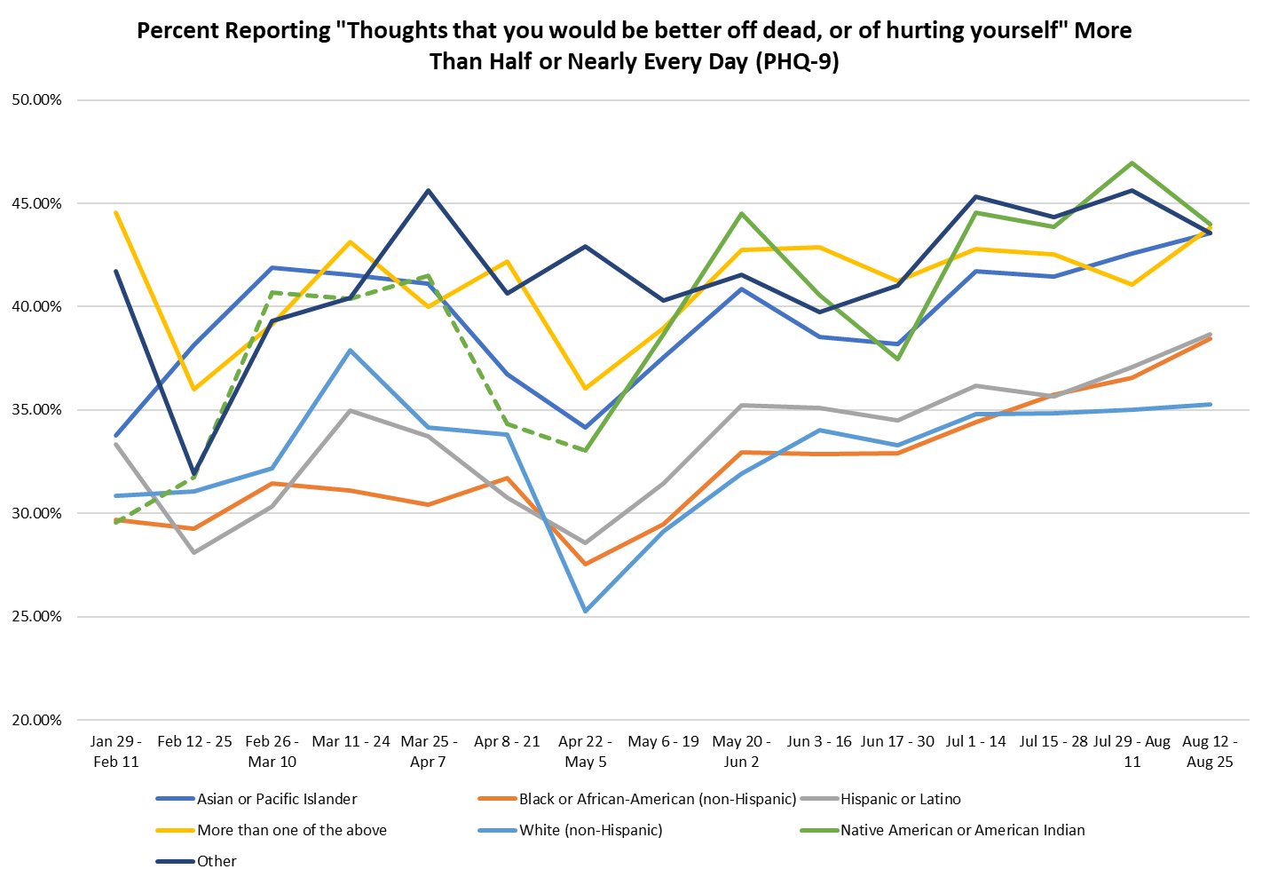
A/PI, Multiracial, Native Am, Other Experiencing More Self-Harm Thoughts

Slide 13
Young People in August Still Disproportionately Experiencing Depression and Anxiety
Percent Moderate to Severe

Slide 14
Young People Experiencing Highest Rates of Suicidal Ideation
17,497
11-17-year-olds with suicidal ideation

Slide 15
Psychosis Screening: Screeners at Risk and Severity Up in August 2020

Slide 16
Special Populations: Positive for Depression and Anxiety

Slide 17
July Anxiety Screeners: The Main Things Contributing to Mental Health Problems Right Now
Reason | Number of Responders | Percent of Respondents
Loneliness or isolation | 19063 | 65.28%
Past trauma | 14206 | 48.65%
Relationship problems | 11994 | 41.07%
Current events (news, politics, etc.) | 9009 | 30.85%
Coronavirus | 8578 | 29.37%
Grief or Loss | 7459 | 25.54%
Financial Problems | 7246 | 24.81%
Racism | 3012 | 10.31%
N=29,202, scoring moderate to severe 7/1-7/31, “Choose up to 3”

Slide 18
August Anxiety Screeners: The Main Things Contributing to Mental Health Problems Right Now
Reason | Number of Responders | Percent of Respondents
Loneliness or isolation | 23437 | 64.42%
Past trauma | 17379 | 47.77%
Relationship problems | 14537 | 39.95%
Current events (news, politics, etc.) | 10953 | 30.10%
Coronavirus | 10717 | 29.46%
Grief or Loss | 9210 | 25.31%
Financial Problems | 9197 | 25.28%
Racism | 3289 | 9.04%
N=36,384, scoring moderate to severe 8/1-8/31, “Choose up to 3”

Slide 19
July Depression Screeners: The Main Things Contributing to Mental Health Problems Right Now
Reason | Number of Responders | Percent of Respondents
Loneliness or isolation | 43396 | 74.39%
Past trauma | 26634 | 45.66%
Relationship problems | 25443 | 43.62%
Grief or loss | 15497 | 26.57%
Coronavirus | 14389 | 24.67%
Current events (news, politics, etc.) | 14261 | 24.45%
Financial Problems | 13995 | 23.99%
Racism | 4450 | 7.63%
N=58,335, scoring moderate to severe 7/1-7/31, “Choose up to 3”

Slide 20
August Depression Screeners: The Main Things Contributing to Mental Health Problems Right Now
Reason | Number of Responders | Percent of Respondents
Loneliness or isolation | 56633 | 73.80%
Past trauma | 35290 | 45.98%
Relationship problems | 33672 | 43.88%
Grief or loss | 20925 | 27.27%
Coronavirus | 19424 | 25.31%
Financial Problems | 18850 | 24.56%
Current events (news, politics, etc.) | 18483 | 24.08%
Racism | 5575 | 7.26%
N=76,743, scoring moderate to severe 8/1-8/31, “Choose up to 3”

Slide 21
Main Concerns Are Different Across Race/Ethnicity
August 2020
Black or African American screeners cite financial concerns at highest rate
Native American or American Indian screeners report more past trauma
Hispanic or Latino screeners more worried about COVID-19
Hispanic or Latino screeners cite loneliness or isolation at highest rates
Native American or American Indian screeners report most grief or loss

Slide 22
For More Resources
For MHA COVID-19 resources: https://www.mhanational.org/covid19
For other mental health COVID-19 resources: https://psychhub.com/covid-19/
To take a free mental health screen: https://screening.mhanational.org

Slide 23
pgionfriddo@mhanational.org
@pgionfriddo

